Slide 1



  Team Name-Drag
  Project Name-RallyRivals
  Selected Theme-Entertainment Reimagined
  Type: Software
  A browser-based, motion-controlled 3D tennis game turning any laptop into a virtual arcade using smartphones as wireless motion controllers.
  Team Members: Karthik Kannan | Raahul Karthick Saravana Selvam

Slide 2
THE PROBLEM
  The cost of consoles like VR and Wii is expensive and we overcome this problem.
  Gamers who can’t affored consoles like VR and Wii
  The UI ,graphics of the game and the mechanics for the game can be improved
  Consoles are expensive and we made a accessible alternative

Slide 3
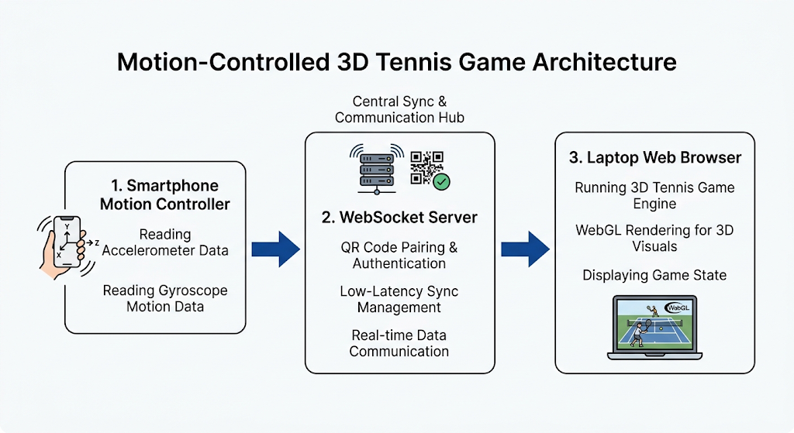
THE SOLUTION
  We are using our mobile as controller and reducing the cost of gaming.
  Connecting gyroscopic controls from your phone to the game using websocket API
  Affordability and accessibility

Slide 4
USER EXPERIENCE
  Scan QR → Connect Phone → Play game
  Easier access through QR

Slide 5
HOW IT WORKS
  Captures motion data via built-in sensors (accelerometer & gyroscope).
  WebSocket pairs instantly via QR code and streams low-latency motion packets.
  Processes physics and renders the live 3D tennis match in WebGL

Slide 6
NOVELTY, IMPACT & SCALABILITY
  Zero-Hardware Installation and instant QR pairing make it unique.
  Replaces screen gaming with active physical movement.
  Can be expanded to many other games like bowling , table tennis , etc.

